Slide 1
MATH 340 Programming in Math First Meeting Lecture Notes #1: Course Overview
Professor Uduak George
Department of Mathematics and Statistics
San Diego State University
San Diego, CA 92182-7720
ugeorge@sdsu.edu
https://ugeorge.sdsu.edu

Slide 2
Contact Information: The Professor
Email: ugeorge@sdsu.edu
Web: https://ugeorge.sdsu.edu
Office Hours: M W. 15:15-16:15 and by appointment
Class Location: *Zoom.us (Live online classes)
*This course will be a delivered through live lectures (synchronous) except for the three weeks shown on the course schedule where material will be delivered through prerecorded lectures (asynchronous).
Zoom link to join live lectures and Dr. George’s office hours is provided on the syllabus.
Syllabus and Course Schedule is available on Canvas.
See syllabus for student assistant (Dewayani Windy) office hours and Zoom link

Slide 3
Course Prerequisites
MATH 151 Calculus II
MATH 245 Discrete Mathematics or equivalent
or Instructor's permission

Slide 4
Course Information
1) Course notes can be found on Github at: https://github.com/uduakgeorge/M340
2) You can also view the notes directly at: https://nbviewer.jupyter.org/github/uduakgeorge/M340/tree/master/Math-340-Notebooks-master/
3) Or by accessing the following website: nbviewer.jupyter.org where you can then search for the GitHub username uduakgeorge

Slide 5
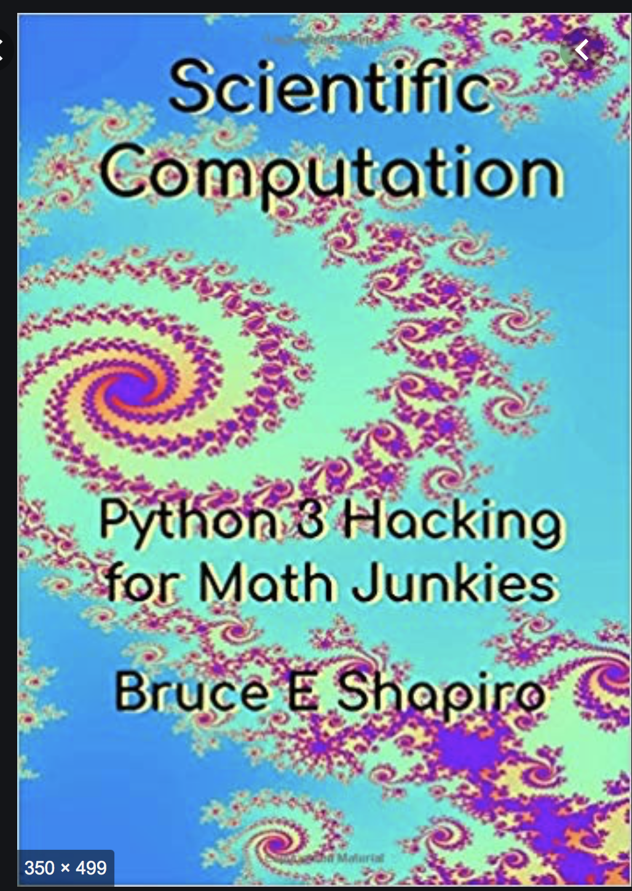
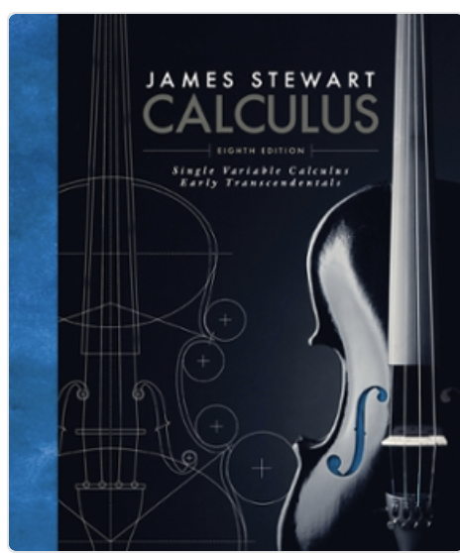
Required and Optional Text
Required Text
Course Notes
Secondary Text
Scientific Computation: Python Hacking for Math Junkies, by Bruce E. Shapiro. ISBN-10: 0692452001; ISBN- 13: 9780692452004. Publisher: Sherwood Forest Books
Single Variable Calculus: Early Transcendentals 8th Edition, by James Stewart. ISBN 978-1-305-27033-6; ISBN-10: 9781305270336; ISBN-13: 978-1305270336. Publisher: Cengage

Slide 6
In-Class Quizzes
We will use Top Hat for in-class quizzes.
In-class quizzes is worth 3% bonus points (participation points).
Attendance to all lectures is required. Attendance will be recorded.

Slide 7
Course Assessment
Your final score will consist of homework (70%), two exams (20%) and final exam (10%).
Exams submitted after the deadline will be worth 80%.

Slide 8
Homework
See course syllabus (available on Canvas) for homework schedule and important dates.
Homework will be posted on Canvas Assignment tab.
Homework is due every Tuesdays and Fridays.
Homework Policy: Any homework that is more that 3 days late but not more than 7 days late will be worth 80%. Any homework that is more than 7 days late will not be graded unless you make arrangement with me in advance.

Slide 9
Schedule (Weeks 1-3)
WK | Dates | Schedule | HW & Exam
1 | Aug 24 – 28 | Course Overview; Python programming: Introduction; Jupyter Notebook HW 1, HW 2, HW 3 and HW 4 assigned | HW 1 Due 08/25 HW 2 Due 08/28
2 | Aug 31 – Sep 4 | Python programming: Introduction; Approximations; Taylor Series HW 5 and HW 6 assigned 09/04 (7:59pm deadline) - Last day for students to add, drop, or change grading basis | HW 3 Due 09/01 HW 4 Due 09/04
3 | Sep 7 – 11 | Taylor Series; Taylor's Remainder Theorem HW 7 and HW 8 assigned 09/07 – Labor Day holiday, no classes. | HW 5 Due 09/08 HW 6 Due 09/11

Slide 10
Grading Scheme
Homework 70%
Two exams 20%
Final exam 10%
The following grading scale will be used:
A 93% - 100% A- 90% - 93%
B+ 87% - 90% B 83% - 87% B- 80% - 83%
C+ 76% - 80% C 72% - 76% C- 68% - 72%
D+ 64% - 68% D 60% -64% D- 55% - 60% F Below 55%

Slide 11
Academic Honesty
The University adheres to a strict policy prohibiting cheating and plagiarism. Examples of academic dishonesty include but are not limited to:
copying, in part or in whole, from another's test or other examination;
obtaining copies of a test, an examination, or other course material without the permission of the instructor;
collaborating with another or others in work to be presented without the permission of the instructor;
falsifying records, laboratory work, or other course data;
submitting work previously presented in another course, if contrary to the rules of the course;
altering or interfering with grading procedures;
assisting another student in any of the above;
using sources verbatim or paraphrasing without giving proper attribution (this can include phrases, sentences, paragraphs and/or pages of work);
copying and pasting work from an online or offline source directly and calling it your own;
using information you find from an online or offline source without giving the author credit;
replacing words or phrases from another source and inserting your own words or phrases.

Slide 12
Classroom Conduct Standards
SDSU students are expected to abide by the terms of the Student Conduct Code in classrooms and other instructional settings. Prohibited conduct includes:
Willful, material and substantial disruption or obstruction of a University-related activity, or any on-campus activity.
Participating in an activity that substantially and materially disrupts the normal operations of the University or infringes on the rights of members of the University community.
Unauthorized recording or dissemination of virtual course instruction or materials by students, especially with the intent to disrupt normal university operations or facilitate academic dishonesty. This includes posting of exam problems or questions to on-line platforms.
Conduct that threatens or endangers the health or safety of any person within or related to the University community, including
physical abuse, threats, intimidation, or harassment.
sexual misconduct.
Violation of these standards will result in referral to appropriate campus authorities.

Slide 13
Students with Disabilities
If you are a student with a disability and believe you will need accommodations for this class, it is your responsibility to contact Student Ability Success Center at (619) 594-6473.
You can also learn more about the services provided by visiting the Student Ability Success Center website.
To avoid any delay in the receipt of your accommodations, you should contact Student Ability Success Center as soon as possible.
Please note that accommodations are not retroactive, and I cannot provide accommodations based upon disability until I have received an accommodation letter from Student Ability Success Center.

Slide 14
Resources for Students
A complete list of all academic support services--including the Writing Center and Math Learning Center--is available on the Student Affairs’ Academic Success website. Counseling and Psychological Services (619-594-5220) offers confidential counseling services by licensed therapists; you can Live Chat with a counselor at http://go.sdsu.edu/student_affairs/cps/therapist-consultation.aspx between 4:00pm and 10:00pm, or call San Diego Access and Crisis 24-hour Hotline at (888) 724-7240.
*Check the course syllabus for active links to the above resources.

Slide 15
What we will learn
You will learn how to program in Python, typeset mathematical symbols and equations in LaTeX and use Jupyter to present mathematical results.

Slide 16
Student Learning Outcomes
The overarching outcomes for this course are:
Learn the `science' of computer programming.
Learn the `art' of computer programming.
Represent abstract mathematics as computer code and translate computer code into mathematics.
Visualize and describe data.
Learn in what ways modern computing is done.

Slide 17
Homework
You are encouraged to work with one another to solve homework problems, but you should write solutions individually.
Do not allow someone else to copy your work. If you suspect a student of cheating please inform me.
The Mathematics and Statistics Department expects academic honesty from our students, as laid out in the University Policies below.
Violations will be reported to the Center for Student Rights and Responsibilities.

Slide 18
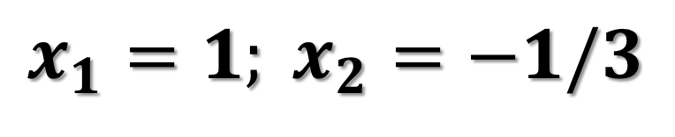
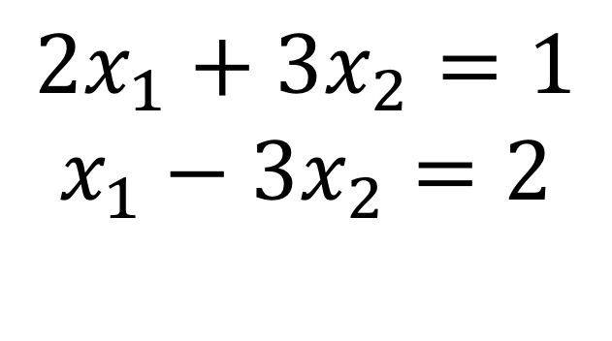
Computer Programming and Mathematics: Importance
Systems of equations in two variables are easy to solve. It gets more time consuming and laborious to solve if you have a system of three or four equations.
$${2x}_{1}+{3x}_{2}=1$$
$$x_{1}−{3x}_{2}=2$$
Applying the substitution method to the system of equations, we obtain the following solutions:
$$x_{1}=1; x_{2}=−1/3$$

Slide 19
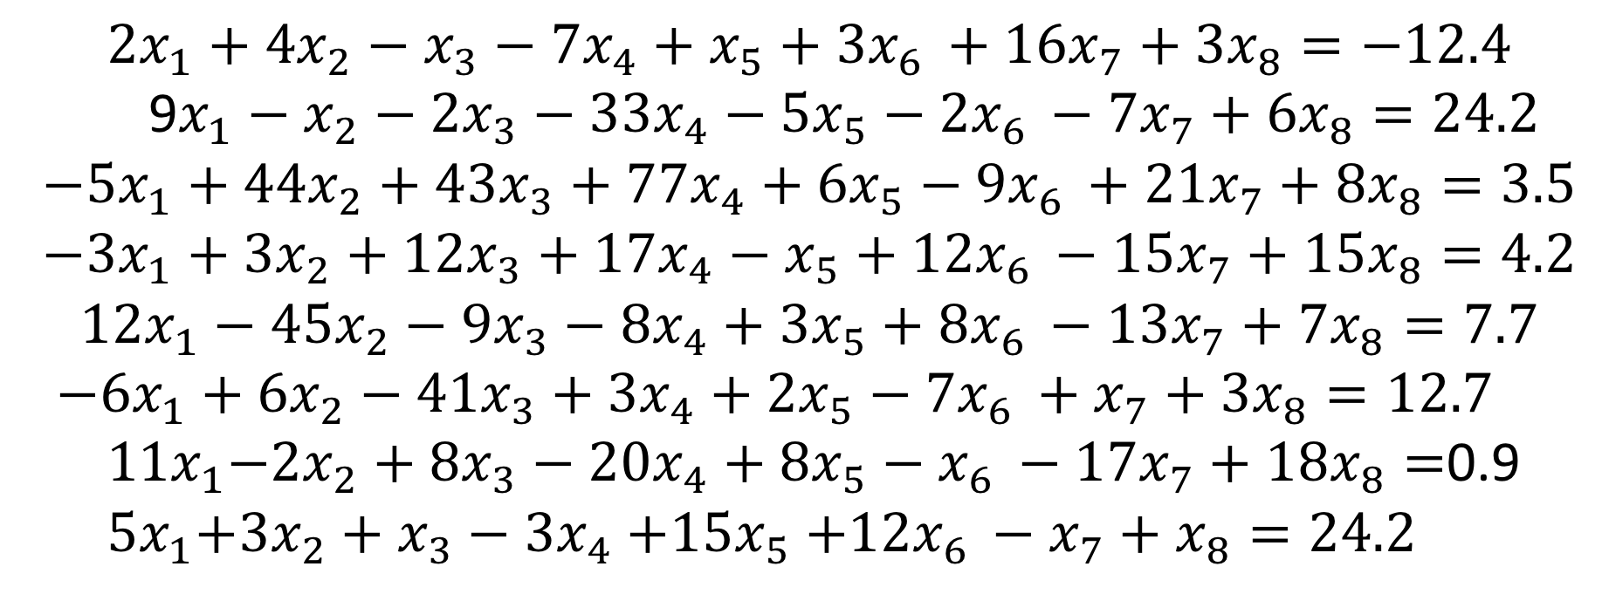
Computer programming can be used to find solutions for the following system of equations
$${2x}_{1}+{4x}_{2}−x_{3}−{7x}_{4}+x_{5}+{3x}_{6 }+{16x}_{7}+{3x}_{8}=−12.4$$
9$x_{1}−x_{2}−{2x}_{3}−{33x}_{4}−{5x}_{5}−2x_{6 }−{7x}_{7}+{6x}_{8}=24.2$
$${−5x}_{1}+{44x}_{2}+{43x}_{3}+{77x}_{4}+{6x}_{5}−9x_{6 }+{21x}_{7}+8x_{8}=3.5$$
$${−3x}_{1}+3x_{2}+{12x}_{3}+1{7x}_{4}−x_{5}+12x_{6 }−{15x}_{7}+{15x}_{8}=4.2$$
$${12x}_{1}−{45x}_{2}−{9x}_{3}−{8x}_{4}+{3x}_{5}+8x_{6 }−{13x}_{7}+{7x}_{8}=7.7$$
${−6x}_{1}+{6x}_{2}−41x_{3}+{3x}_{4}+{2x}_{5}−7x_{6 }+x_{7}+{3x}_{8}=12.7$
${ 11x}_{1}−{2x}_{2}+8x_{3}−{20x}_{4}+{8x}_{5}−x_{6 }−{17x}_{7}+18x_{8}=$0.9
${ 5x}_{1}+3x_{2}+x_{3}−{3x}_{4}{+15x}_{5}+12x_{6 }−x_{7}+x_{8}=24.2$

Slide 20
Computer programming: Solving Laborious Tasks
Python is a programming language that enables us to use computers to solve complex, tedious or difficult tasks.
Example
The sum of numbers from 1 to 1,000,000 can be done easily in Python.

Slide 21
Computer Program
To tell a computer what to do you give it instructions in a computer language.
The name of the language that we will use in this class is Python.
A Computer Program is a sequence of instructions for a computer, so that it can perform a specific task.

Slide 22
Syntax and Semantics
The syntax of a computer language describes very precisely how to form statements the computer understands.
If there is any deviation from the rules, even the smallest, the computer will recognize that there is an error, and it will tell you so.
The semantics of a computer program describe what it is supposed to do.
A semantic error that is not a syntactic error will not cause the program to halt. Instead, it will do something funny.

Slide 23
Statement and Code
The instructions in a computer program are called statements.
When you program in python, the text you write is called code.

Slide 24
Why Python?
Python has generic programming structures that are common to other computer languages. If you already know another programming language, then Python is easy to learn.

Slide 25
Why Python?
It is free on all operating systems. Thus students can install it on their laptops or home computers and are not chained to computer labs or expensive license agreements.
Python is completely documented online, and there are lots of books you can download for free to learn more about it.

Slide 26
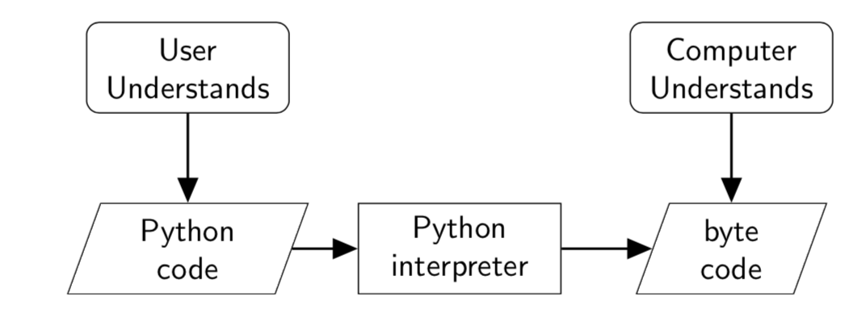
We will use the same word – python – to refer to:
the language (the syntactical rules),
the written language (the code or programs), and
the computer program that translates your python code into machine language or byte code.

Slide 27
Jupyter notebooks
One of the advantages of using notebook is that you can readily access some of the most sophisticated features of python within your browser.
Step-by-step guide to accessing Jupyter notebooks:
Go to (Start-> Anaconda-> Jupyter) to open Anaconda
In Jupyter notebook dashboard, click on new->python 3
Save the new jupyter notebook as lecture 1 demo

Slide 28
Do the following by next class!
Install Anaconda (Python 3 version) on your personal computer.
https://www.anaconda.com
*HW 1 is due Tuesday August 25.
*HW 2 is due Friday August 28.

